Slide 1

Team Alt+F4:
Kaloyan Dinev, Stanislav Todorov, Borislav Ferdinandov, Danislav Todorov, Rosen Papazov

Slide 2
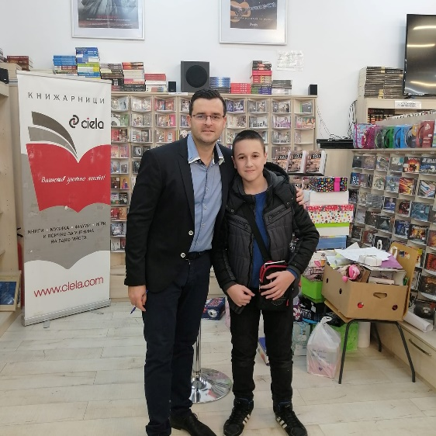
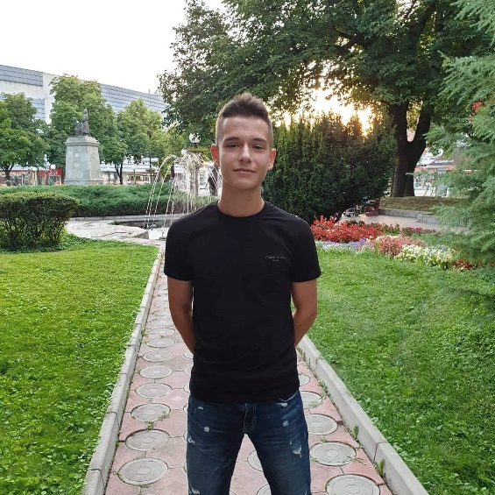
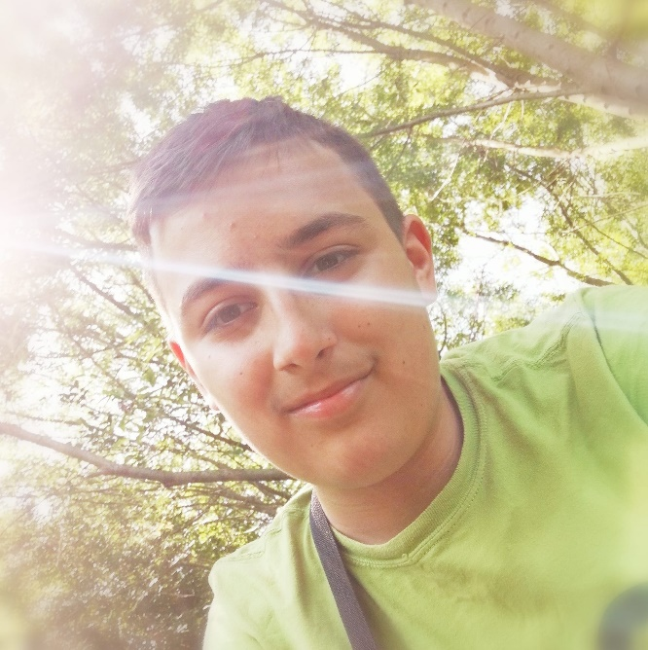
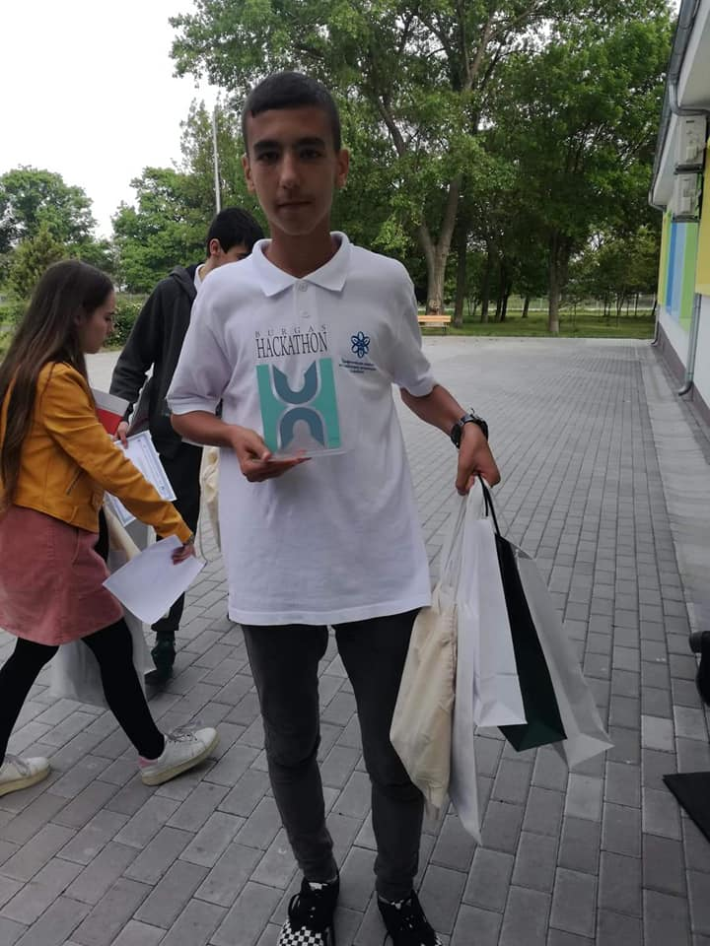
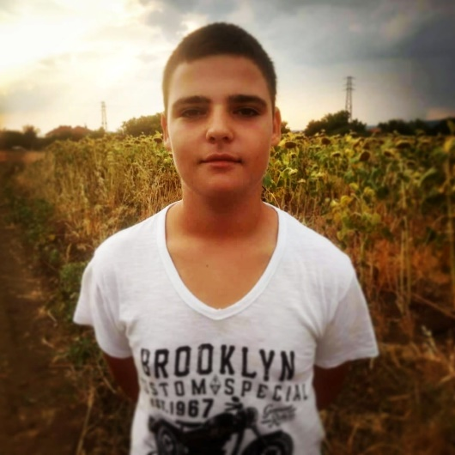
Our team
Danislav
Borislav
Kaloyan
Rosen
Stanislav

Slide 3


Idea of the project
Our idea was to make an adventure game which can be played by one or two people.

Slide 4

Problems with the project
We had some problems with the sound of the game.
The time wasn’t enough.

Slide 5








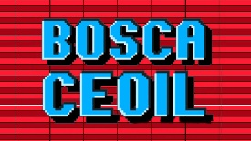




Slide 6


More levels
Boss fights
More mods

Slide 7


